Slide 1
Goal Directed Design of Serial Robotic Manipulators
ASEE Zone 1 Conference
Sarosh Patel & Tarek Sobh
RISC Laboratory
University of Bridgeport

Slide 2
Objective
To design manipulators based on task description such that task performance is guaranteed under user specified task / operating constraints.
A manipulator task can be properly described in terms of the end-effector positions and orientations required.
The operating constraints in terms of joint angle limitations for each of the joints
This methodology generates the appropriate kinematic structure for the given task

Slide 3
Presentation Outline
Introduction
Problem Statement
Overview of the Solution Methodology
Committee Feedback
Results
Analysis of the Results
Contributions
Conclusions
Future Work

Slide 4
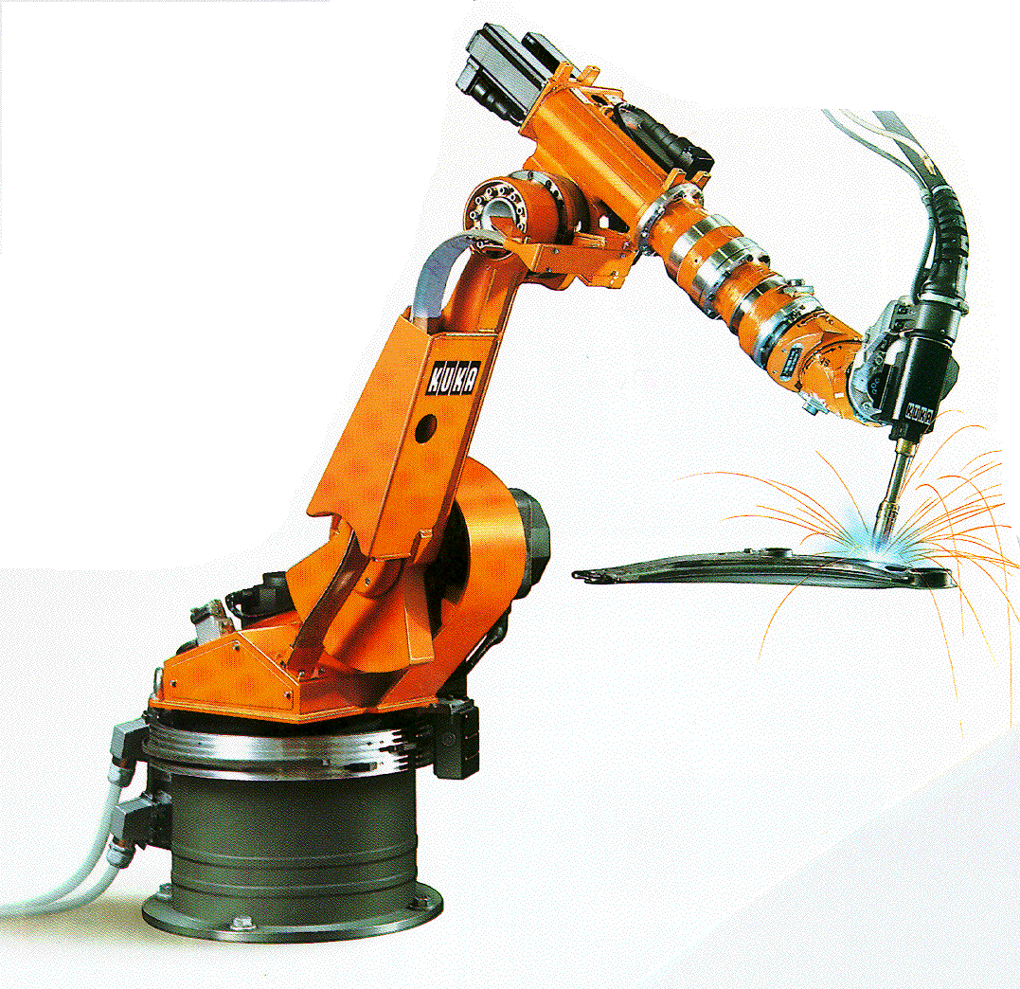
Serial Robotic Manipulators
Open kinematic chain of mechanical links
Physically anchored at the base
Mostly consist of a manipulating links followed by a wrist
Serial manipulators are by far the most commonly found industrial robots
A $2 Billion industry

Slide 5
Task Based Design
Task optimized manipulators are more effective, efficient and guarantee optimal task performance under constraints
There is a close relation between the structure of manipulator and its kinematic performance
A need to reverse engineer optimal manipulator geometries based on task requirements
The ultimate goal of task based design model is to be able to synthesize optimal manipulator configurations based on the task descriptions and operating constraints
An overall framework to generate optimal designs based on specific robot applications is still missing

Slide 6
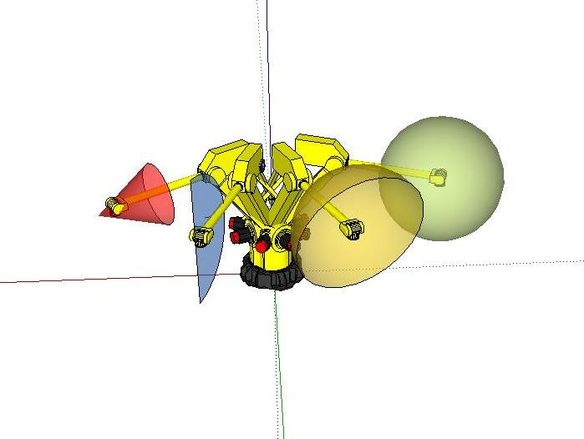
Problem Statement
Task Visualization

Slide 7
Problem Statement
Even though the design criteria can be infinite, depending on the manipulators application
We begin with a set of minimum criteria, such as, the ability reach and to orient the end-effector and generate velocities in arbitrary directions at the task points
Basic requirements for task-based design
Reachability ( includes orientation)
Manipulability (ability to generate velocities in arbitrary directions)
Operating constraints – joint limitations
Based on the above criteria the methodology should be able to generate optimal manipulator structure (DH Parameters)

Slide 8
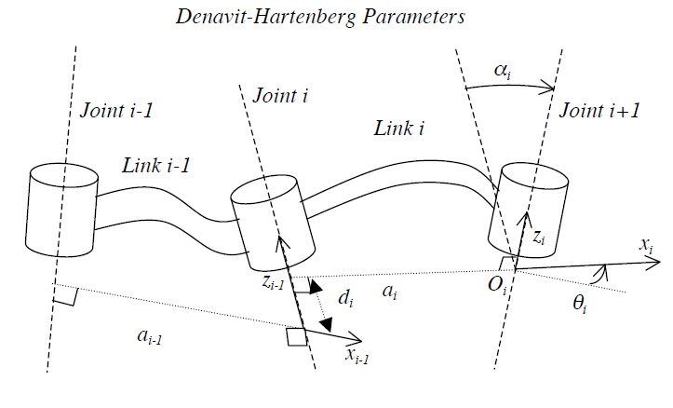
Kinematic Structure
Using the Denavit-Hartenberg (DH) notation, each manipulator link can be represented using four parameters
Link Length (a)
Link Twist (α)
Link Offset (d)
Joint Angle (θ)
If link is revolute θ is variable, if prismatic d is variable
Three parameters required to describe any link

Slide 9
Kinematic Structure
Design parameter for revolute link –
Design parameter for prismatic link –
3n parameters are required to define an n-degree of freedom manipulator
The Configuration set (DH) for a n-DoF manipulator is given as:

Slide 10
Assumptions
The robot base is fixed and located at the origin
The task points are specified with respect to the manipulator’s base frame
The joint limitations are known to the designer.
The last three axis of the manipulator constitute a spherical wrist
To limit the number of inverse kinematic solutions only non-redundant configurations are considered.

Slide 11
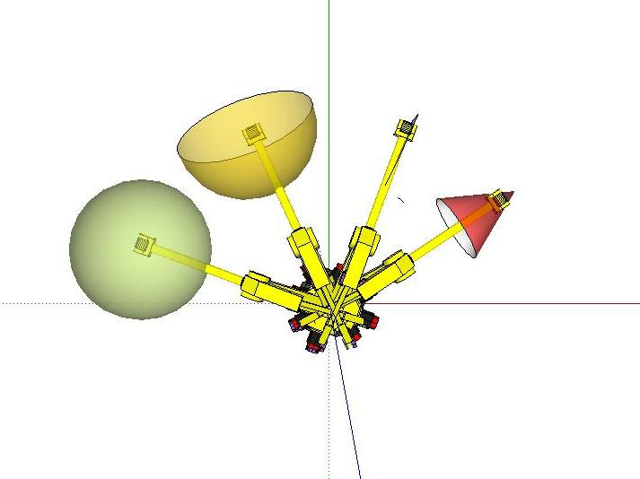
Solution Methodology
Let P be the set of m task points that define the manipulators performance requirements
All these point belong to the 6-dimensional Task Space (TS) that combines position and orientation of the manipulator
are the real world coordinates
and are the roll, pitch and yaw angles about the standard Z, Y and X -axis

Slide 12
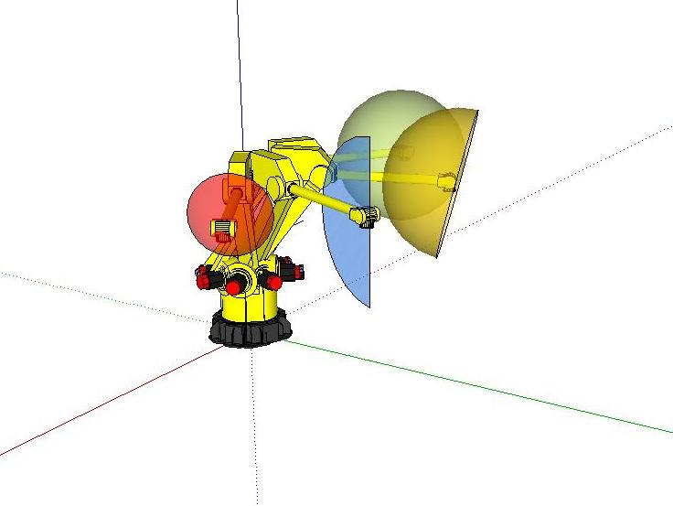
Solution Methodology
Let the set of task point P be represented as:
where and
For task points requiring multiple orientations remains constant, while will assume different values

Slide 13
Constrained Joint Space
The joint vector for n-DoF manipulator is
Every joint vector defines a unique manipulator pose and a distinct point in the n-dimensional Joint Space (Q)
Since the joints are constrainted with lower and upper bounds
Constrained joint space (Qc) is the
set of possible joint angles that the
are within the joint limits

Slide 14
Reachability
Find all DH such that for all points in P, there exists at least one joint vector q within Qc, such that f(DH,q) = p
Excluding singular postures
Find all DH such that
There will be many configurations that can satisfy the above condition
The resulting set of configurations will have a few configurations that can satisfy the above condition only in singular posture
The reachability criterion encompasses the end-effector orientation too

Slide 15
Reachability
Location of the Task Point ‘P’ | reachability() value
P inside the workspace and at least one solution is within joint constraints | [0 1]
P inside the workspace and the only solution has at least one of the joint angles at its maximum displacement | 0
P inside the workspace and the one of the solutions is the one with all joints displacements mid-range | 1

Slide 16
Solution Methodology
Extending the same reachability criterion to all ‘m’ task points in P, we have:
Minimizing this function over the configuration space while give the optimal manipulator configuration that can reach all task points with mid-range or close to mid-range joint displacements

Slide 17
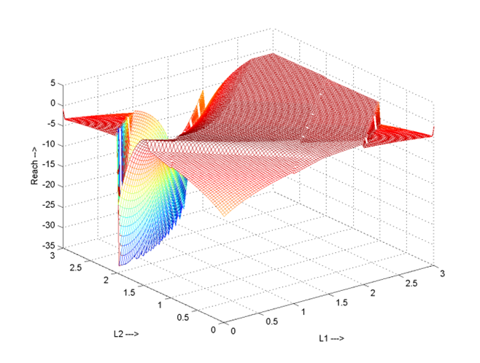
Planar Manipulator Reachability

Slide 18
Optimization
Reachability function is highly non-linear
Having multiple local minimum points
The number of local minima increase with increasing number of task points
Local optimization methods yield an acceptable solution but not a global or optimum solution
Global optimization routines are needed to search beyond local minima and find a global minimum
Simulated Annealing Method is used for global minimization

Slide 19
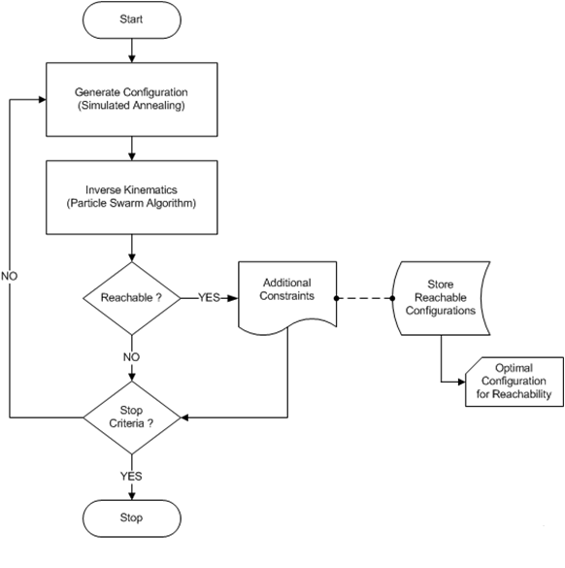
Methodology Flow Chart

Slide 20
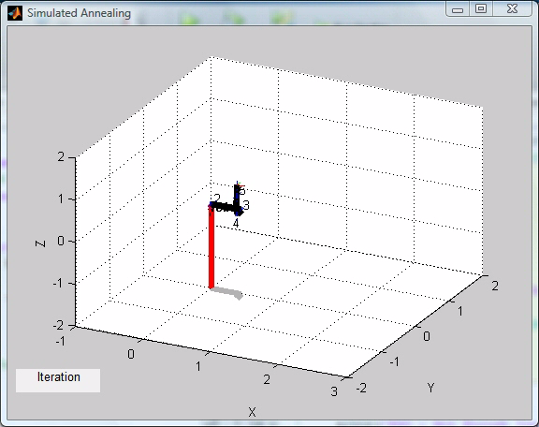

Structures Generated by Simulated Annealing

Slide 21
Particle Swarm Optimization
Essentially an algorithm for simulating the social behavior of animals that act in a group like school of fish or flock of birds.
Particles/agents in the swarm follow few very basic rules
It was later adapted for solving global optimization problems
PSO can explore and exploit the search space better than other algorithms
With a few simple modifications multiple global minima can be found using PSO

Slide 22
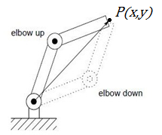
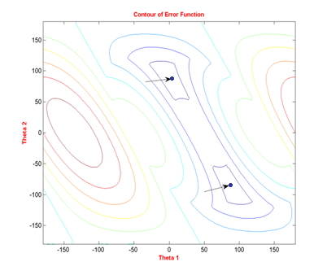
Inverse Kinematics using PSO
The position error function for a planar two link manipulator is below

Slide 23
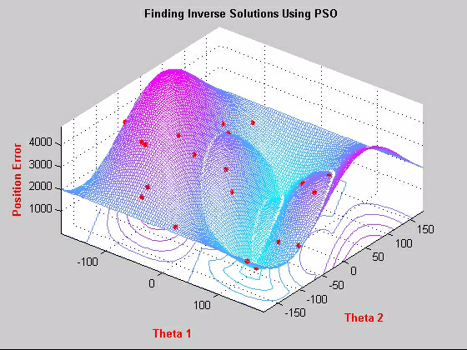
Inverse Kinematics using PSO

Slide 24
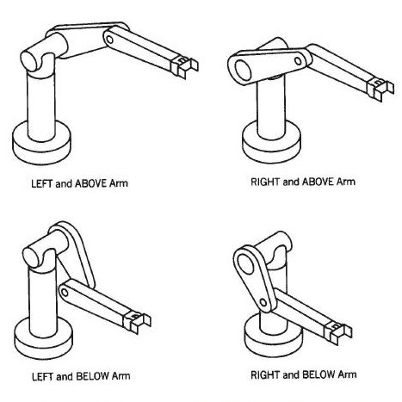
Puma Arm Inverse solutions
Four solutions inverse position solutions for most points in the reachable workspace
And multiple inverse solutions for the wrist depending on the position of the arm

Slide 25
Inverse Kinematics using PSO
For the 6-dimenional problem, we decompose the problem into 2 sub-problems – Positioning and Orientating
Greedy Optimization – The optimal solution to a large problem contains optimal solutions to its sub-problems
First run of PSO finds the joint angles necessary to position the arm at the required task point
In the second run, for every position solution, PSO finds wrist joint angles necessary to achieve the desired orientation
With a few simple modifications multiple global minima can be found using PSO
Thresholding
Grouping particles

Slide 26
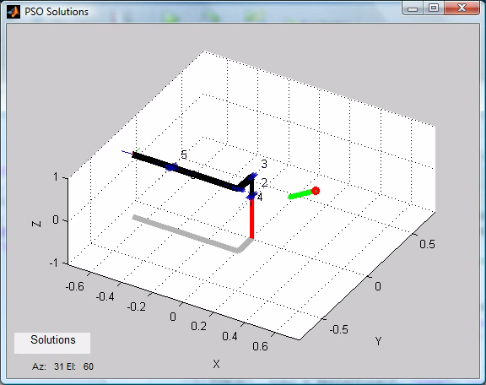
Puma Inverse Kinematics using PSO
Puma560 Joint limits
LB = [-160, -45, -225, -110, -100, -266]
UB = [160, 225, 45, 170, 100, 266]

Slide 27
Inverse Kinematics using PSO
Advantages
Solutions are found within joint specified joint limits (constrained joint space)
Multiple inverse solutions can be found together
Works with a general formulation of the problem
Does not require multiple runs with random seed like the traditional numerical methods
Disadvantages
Slow when compared to closed form analytical solutions

Slide 28
Experiments
Generating new optimal structures for a set of tasks
The methodology is applied to a wide range of tasks
Varying number of task points
Constant and changing orientations
Optimizing existing manipulator structures
Optimizing a Puma560 manipulator

Slide 29
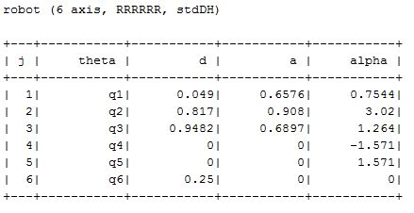
Ring Task Goal
Ring Goal = [
0.7000 0.5000 0 -3.142 0 -3.142
0.6414 0.6414 0 -3.142 0 -3.142
0.5000 0.7000 0 -3.142 0 -3.142
0.3586 0.6414 0 -3.142 0 -3.142
0.3000 0.5000 0 -3.142 0 -3.142
0.3586 0.3586 0 -3.142 0 -3.142
0.5000 0.3000 0 -3.142 0 -3.142
0.6414 0.3586 0 -3.142 0 -3.142
];
Best Reachablility

Slide 30
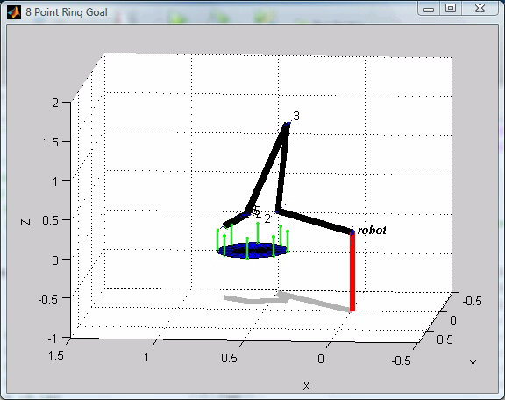
Ring Task Goal

Slide 31
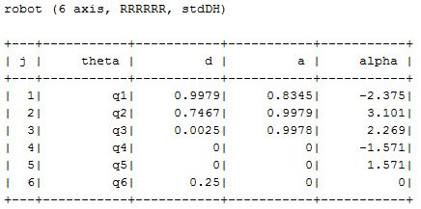
Sphere Goal
Sphere Goal = [
0 0.75 0 0 0 0;
0 0.75 0 -3.142 0 -3.142;
0 0.75 0 0 1.565 0;
0 0.75 0 0 -1.565 0;
0 0.75 0 -1.372 1.541 -3.142;
0 0.75 0 1.784 -1.571 -0.213
];
Best Reachablility

Slide 32
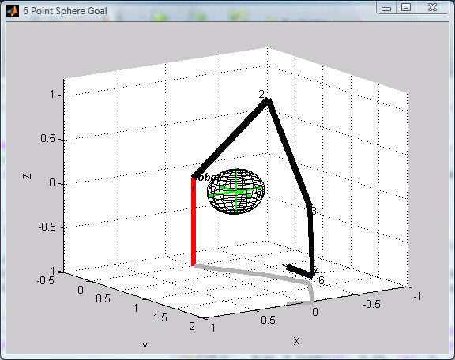
Sphere Goal

Slide 33
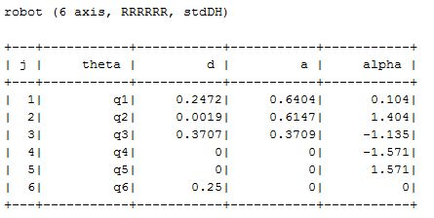
Horizontal Plane Goal
Horizontal Plane Goal = [.
0.9 -0.5 0 -3.142 0 -3.142;
0.9 0 0 -3.142 0 -3.142;
0.9 0.5 0 - 3.142 0 -3.142;
0.7 -0.5 0 -3.142 0 -3.142;
0.7 0 0 -3.142 0 -3.142;
0.7 0.5 0 -3.142 0 -3.142;
0.5 -0.5 0 -3.142 0 -3.142;
0.5 0 0 -3.142 0 -3.142;
0.5 0.5 0 -3.142 0 -3.142;
];
Best Reachablility

Slide 34
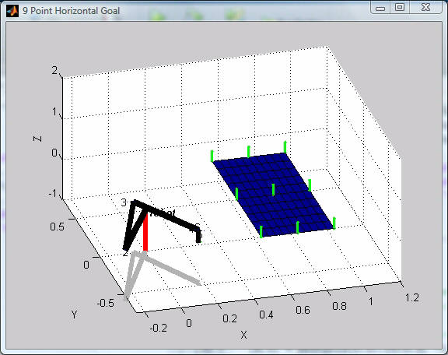
Horizontal Plane Goal

Slide 35
Analysis of the Results
In most of the task goals experimented the best manipulator structure was found to be RRR/RRR structure, supporting the fact that most industrial manipulators are of this type
Making the joint displacement and joint twist angles continuous greatly improved the reachability of the structures
In the case of a few structures the algorithm failed to reach all the task points. For example, RPP/RRR configuration could not accomplish the spherical task goal with in the given joint limitations

Slide 36
Conclusions
In this work we have present a general methodology for task based prototyping of serial robotic manipulators
This framework can be used generate task specific manipulator structures based on the task descriptions
The frameworks allows for practical joint constraints to be imposed during the design stage of the manipulator
Existing structures can be checked for task suitability and optimized
The methodology works well with both analytical and numerical inverse kinematics module
A novel approach to finding the inverse kinematic solutions using PSO is also presented

Slide 37
Future Work
Adding a library of known manipulator configurations, such as PUMA, SCARA, FANUC, Mitsubishi etc for easy look up of task suitability of existing manipulators and if need be, modify them
Adding additional criteria for optimizing the structures
Incorporating obstacle avoidance features, where in the manipulator can reach the task point while avoiding a certain obstacles
Further developing the PSO based inverse kinematics module using dynamic swarming and attract/repel swarm strategies

Slide 38
Questions ?

